Slide 1
Basic models
Cloud AI

Slide 2
Machine learning
Supervised learning
Reinforcement learning
Classification
Regression
Clustering
Dimensionality reduction
Unsupervised learning
BI Project!
Notes:
We’ll be doing the orange parts

Slide 3
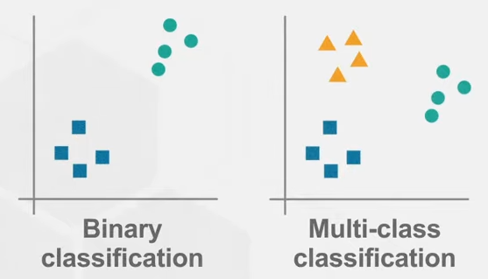
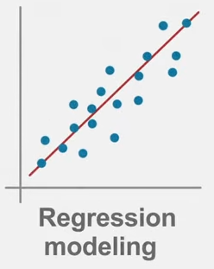
Supervised: Classification vs regression
Classification
Output is class label (discrete)
Looking for boundaries
Evaluate using accuracy
Binary: 2 labels, Multi-class: more than 2 labels
Regression
Output is number (continuous)
Looking for best fit line
Evaluate using sum of squared error (r²)
Notes:
https://www.youtube.com/watch?v=G_0W912qmGc
https://www.youtube.com/watch?v=rHeaoaiBM6Y

Slide 4
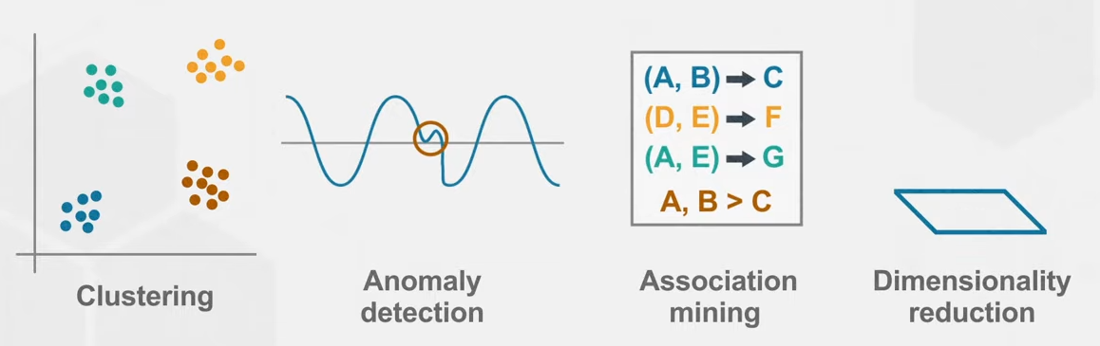
Unsupervised learning
Does not require a data scientist to prepare the data
Example: https://www.kaggle.com/code/ryati131457/titanic-unsupervised-kmeans
Some preparation
No guiding on which groups to make (you can’t ask the model who survived)
But you get 5 groups of people that are at roughly the same location in some multidimensional space ^{(see next slide)}
Good to give insights in data beyond what regular statistics can do
Notes:
https://www.youtube.com/watch?v=rHeaoaiBM6Y
https://towardsdatascience.com/why-we-use-unsupervised-learning-with-k-means-clustering-from-scratch-1401efdd6fde

Slide 5
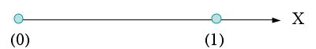
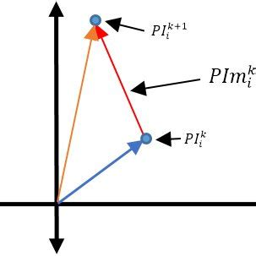

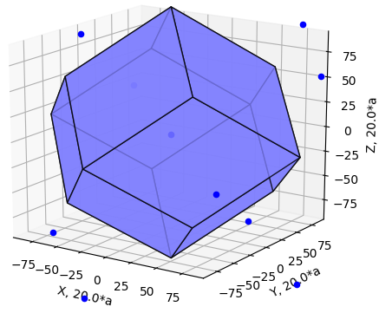


Multidimensional space
One dimensional:
Two dimensional:
Three dimensional:
More dimensional:
17 dimensions?
No problem.

Slide 6
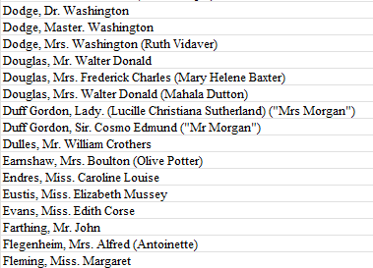
Feature engineering
Feature: measurable input that can be used in a predictive model
Price per ticket to predict survival of Titanic
Feature engineering: convert raw observations into features
Name contains title (Mr., Mrs., Master., Lady., Sir., …)
Extracting this will yield a very valuable feature
Remember that we are doing supervised learning, so we are responsible for providing the model with the data and labels
Notes:
https://towardsdatascience.com/what-is-feature-engineering-importance-tools-and-techniques-for-machine-learning-2080b0269f10
https://www.kaggle.com/datasets/vinicius150987/titanic3

Slide 7
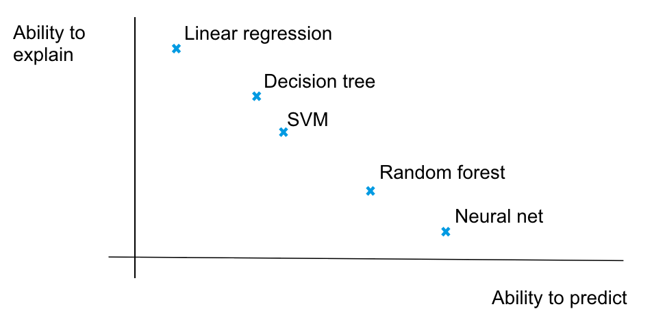
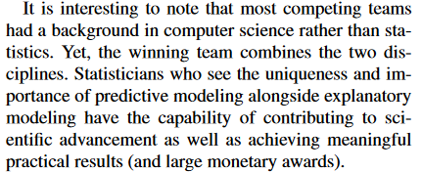
Creating models
We’ll be creating models that fit our data
In essence, any model can be used to predict and any model can be used to explain our data
But some models are better suited to the one or the other
Notes:
https://www.stat.berkeley.edu/~aldous/157/Papers/shmueli.pdf
https://medium.com/@nsorros/to-predict-or-to-explain-ddeb95ba9e25

Slide 8
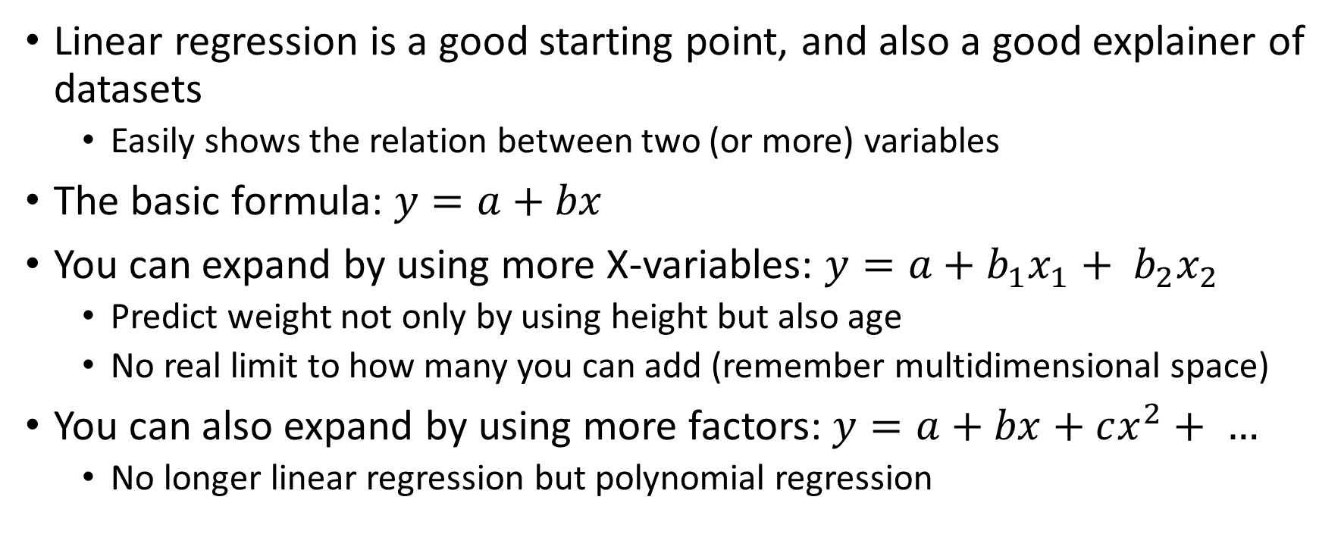
Linear regression
Linear regression is a good starting point, and also a good explainer of datasets
Easily shows the relation between two (or more) variables
The basic formula: $y=a+bx$
You can expand by using more X-variables: $y=a+b_{1}x_{1}+ b_{2}x_{2}$
Predict weight not only by using height but also age
No real limit to how many you can add (remember multidimensional space)
You can also expand by using more factors: $y=a+bx+cx^{2}+ …$
No longer linear regression but polynomial regression

Slide 9
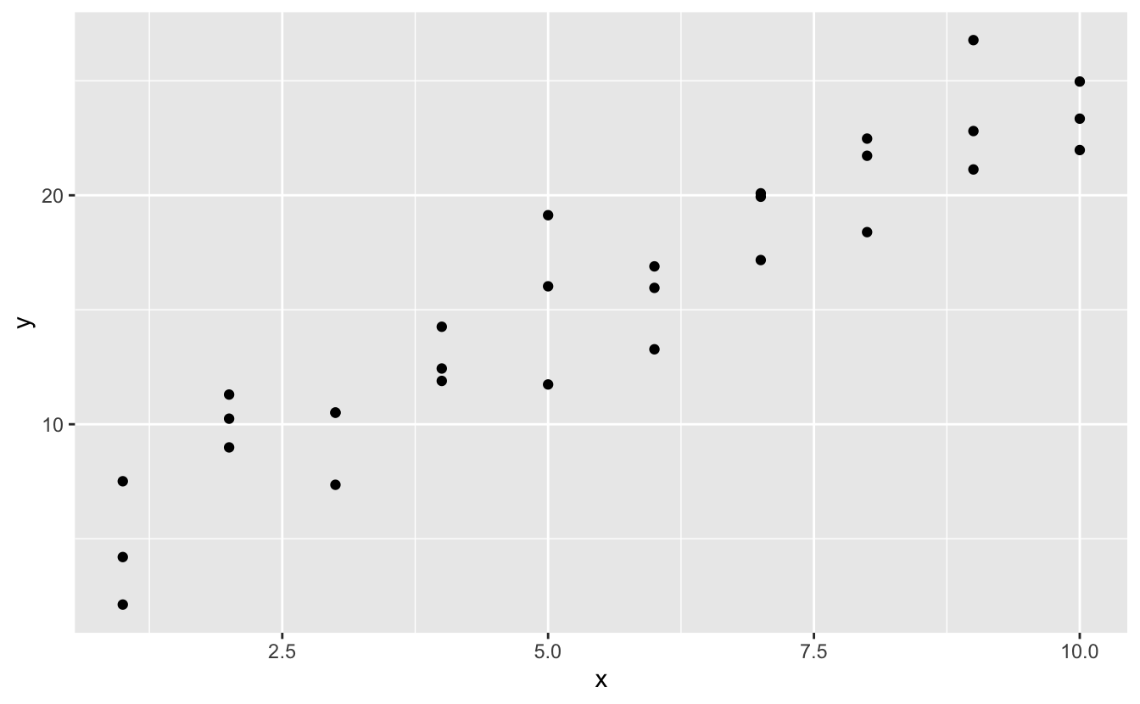
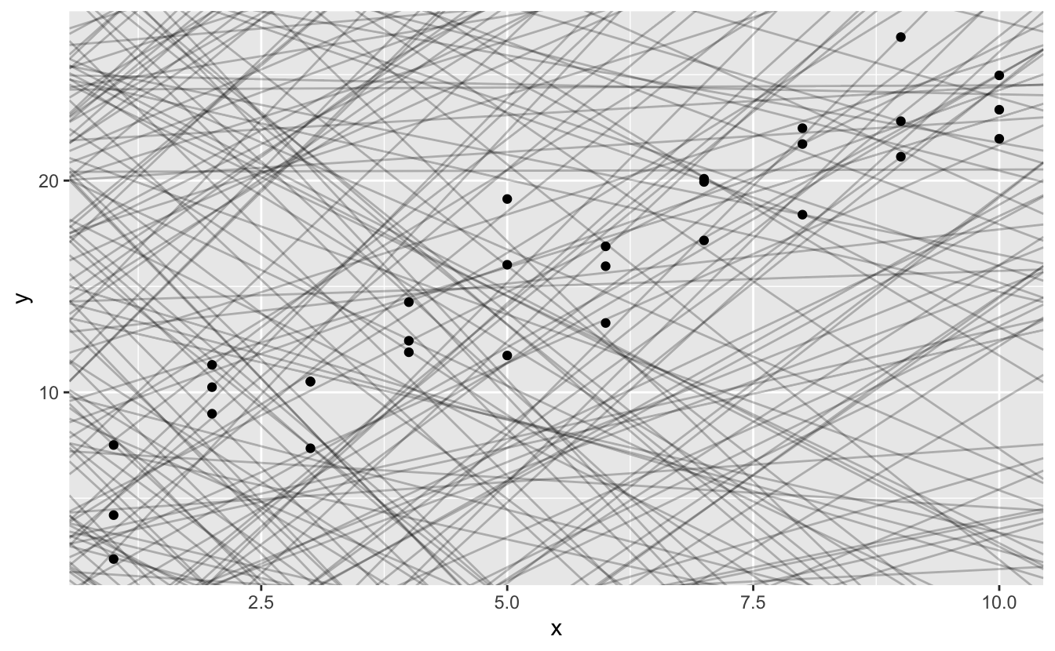
How does linear regression work?
Different (a, b) combinations

Slide 10
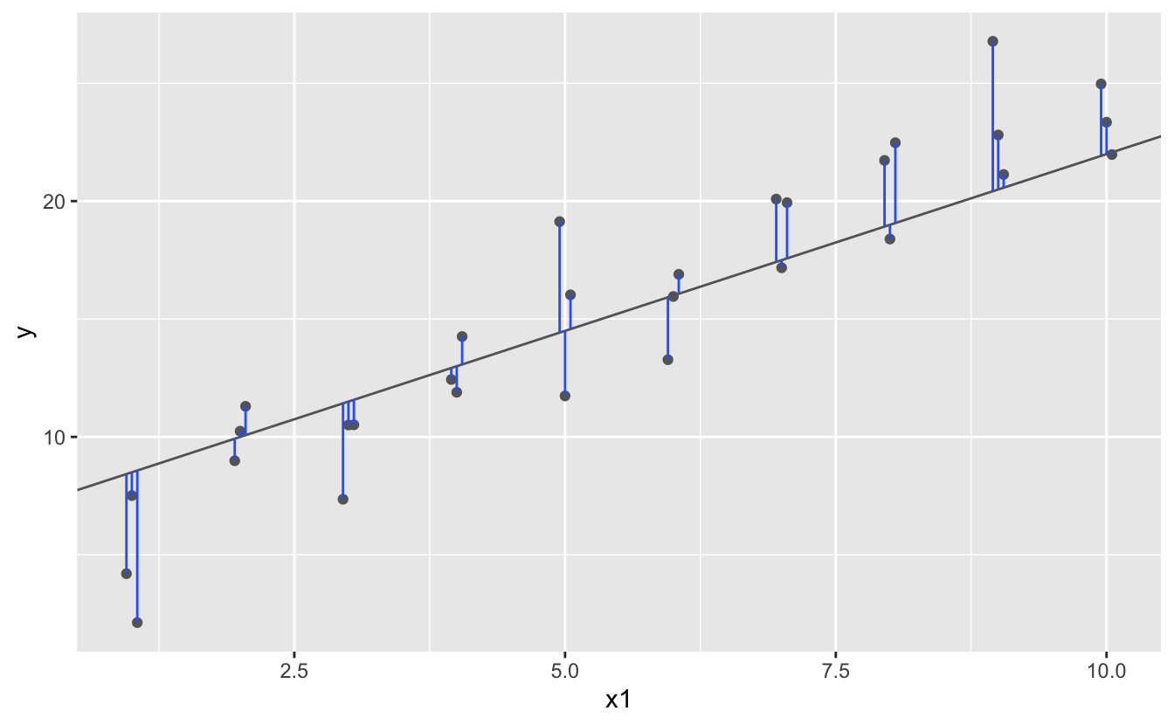
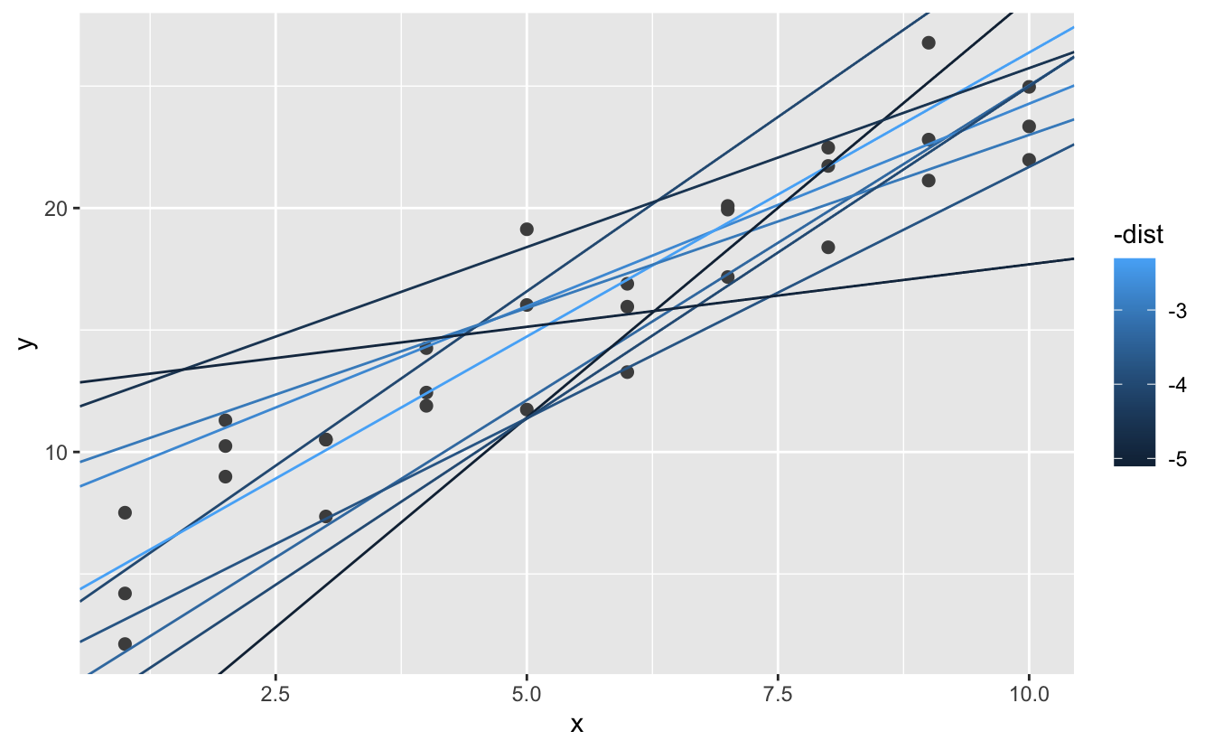

How does linear regression work?
Root-mean-square error

Slide 11
Root mean square?
Why do we use the RMSE to determine how good a model is?
There are other ways, but they have issues:
Simply add the errors: some errors are positive, others are negative. This doesn’t add up well.
Add the absolute value of the errors: Could work but we really want to penalize the big errors.
MSE: Same as RMSE, but not the root. Is a good metric but isn’t in the same unit as the actual data (as it’s still squared). (See link in notes.)
RMSE: Squaring gets rid of the sign and increases the big errors. Value can be compared to the actual data.
Notes:
https://www.statology.org/mse-vs-rmse/
https://towardsdatascience.com/what-does-rmse-really-mean-806b65f2e48e

Slide 12
Calculating the residuals
The residuals are the differences between the calculated values and the predicted values, the errors
Remember that we were always working with two variables
If the residuals no longer show a pattern, that was the main defining correlation in the data
If the residuals still show some kind of a pattern the model doesn’t fully define the data (and won’t be able to predict it)

Slide 13
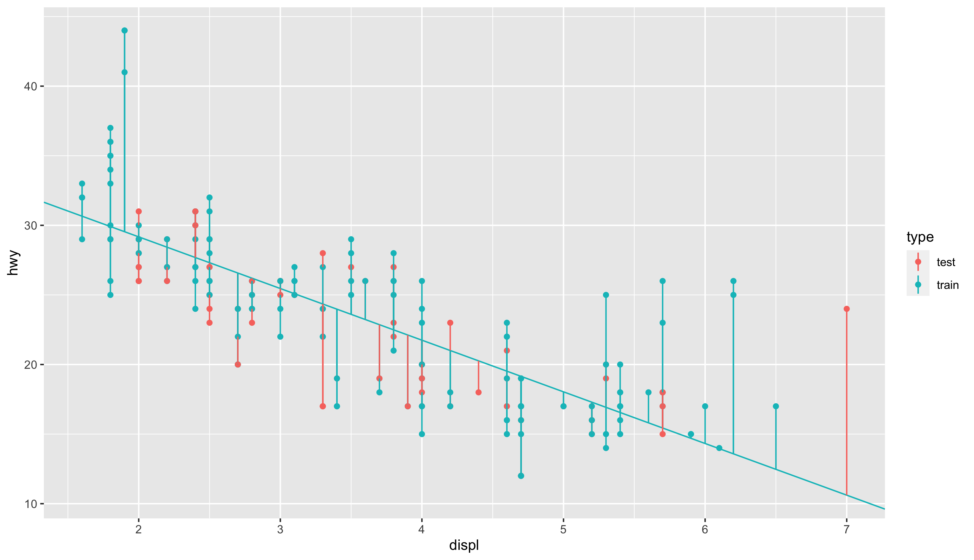
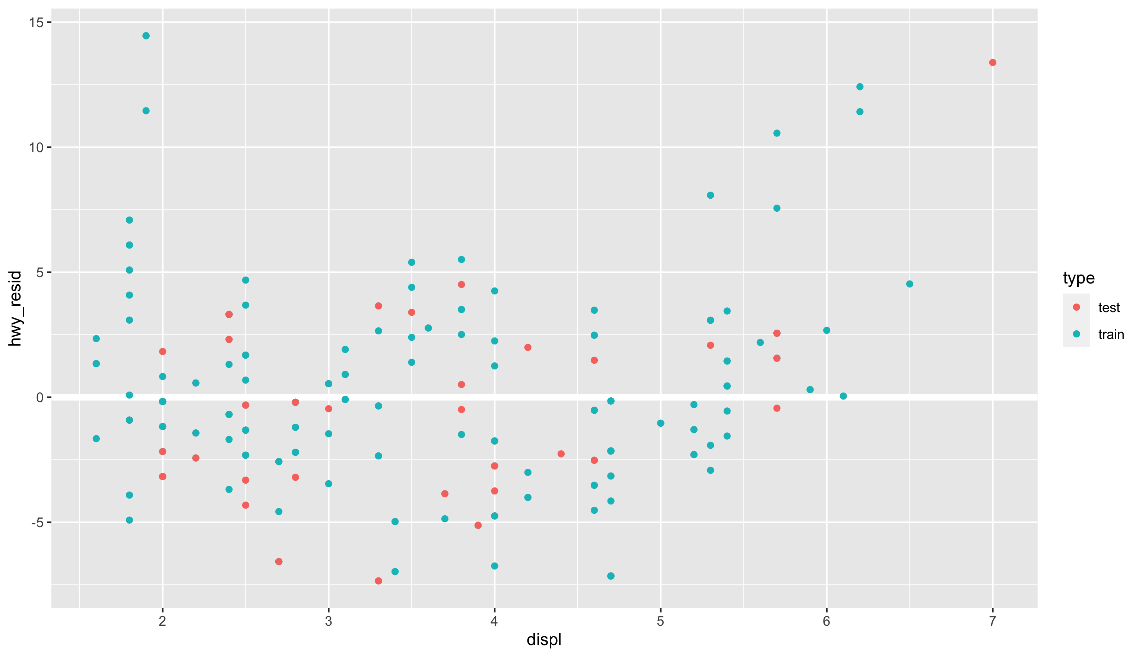
Calculating the residuals
hwy_{resid} = hwy_{actual} – hwy_{predicted}

Slide 14

2.1 – Linear regression
The MPG-dataset contains a number of cars with their weight, engine type, number of seats, …
If we focus only on size of engine, can we reliably predict miles per gallon using a linear regression?
This notebook starts out manually, but also introduces RMSE using the sci-kit library

Slide 15
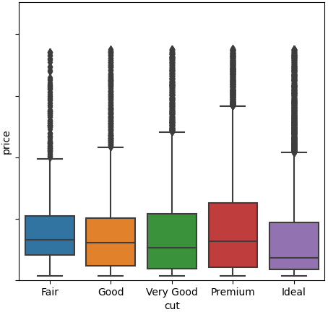
2.2 - diamonds modeling
Every diamond has a certain cut
https://youtu.be/tXdPlZPI9qM?si=g-L1KZUfAPfdx4_V
You would expect a diamond of a better cut to be more expensive, but it isn’t:
Why? Because size matters more
Use a model to proof show that if we take weight out of the equation, cut is important

Slide 16
Tools
A lot of tools are needed at this point. You’ve come across some of them last year in the datascience course in 2ITF, but make sure you’re still comfortable with all of them.
Python running in Jupyter notebooks on SageMaker
And as libraries:
Pandas
Matplotlib
Numpy
Seaborn
Scikit-learn
…

Slide 17
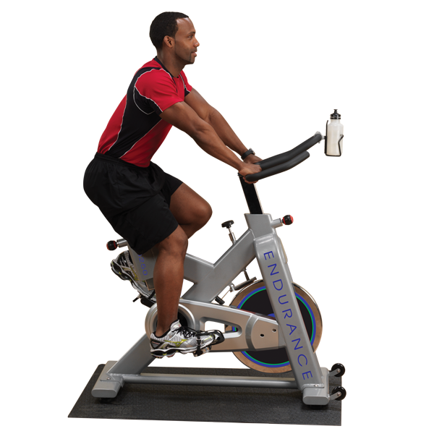
2.1 - University ranking.ipynb

Slide 18
2.2 – Student grades.ipynb

Slide 19
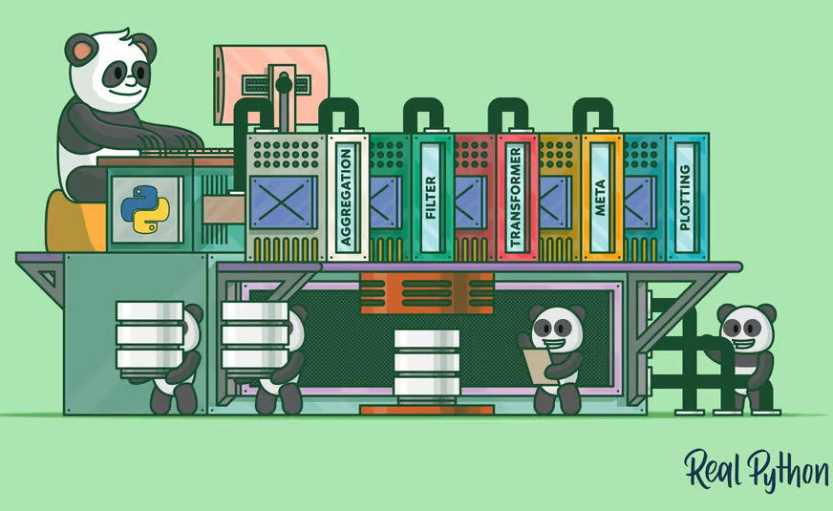
2.3 - groupby example
An example of grouping data
Takes a look at the various options you have and what can go wrong
Notes:
https://realpython.com/pandas-groupby/

Slide 20

Chapter 2

